Slide 1

Bangladesh Army University of Engineering & Technology (BAUET)
Qadirabad, Natore-6431
Department of Computer Science and Engineering
Course Code: CSE-3200
Course Title: Integrated Design Project / Capstone Project
Project Presentation on “Custom ROM”
SUBMITTED BY | SUBMITTED TO
Name: Fathma Khatun Mim | Mohammed Golam Sarwar Bhuyan
ID:20104002 | Professor & Head, Dept of CSE, BAUET
Name: Gourob Roy | Bristi Rani Roy
ID:20104027 | Lecturer, Dept. of CSE, BAUET
Name: Md. Arik Rayhan
ID:20104033
Batch: 11th
Year: 4th
Semester: 1st
Session: 2020-2021

Slide 2
Table of contents
01. | Introduction | 11. | Design Specification
02. | Problem Statement | 12. | Use Case
03. | Motivation | 13. | Data diagram
04. | Objectives | 14. | Front End
05. | Background Study | 15. | Budget
06. | Existing System | 16. | Cost benefit
07. | Comparative Analysis | 17. | Impact on Society
08. | Challenges | 18. | Future Work
09. | Project planning | 19. | Conclusion
10. | Requirement specification | 20. | Reference
05-12-2023
01

Slide 3
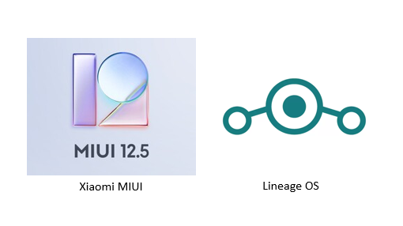
Introduction
A custom ROM is a modified version of the Android operating system. ^{[1]}
Custom ROMs can:
Enhance performance and overall speed
Bring an old device up-to-date
Allow users to focus on privacy and security
Give your phone a whole new look
02
05-12-2023

Slide 4

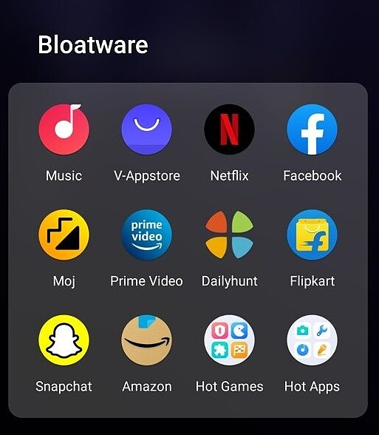

Problem Statement
Current problem of stock ROM:
Privacy and Security
Bloatware and unwanted apps
Unrestricted access to apps and websites
Less control over OS
05-12-2023
03

Slide 5

Motivation
The motivation behind our project:
To make a custom-tailored ROM for Parental Control.
Develop a custom ROM that focuses on the privacy of its users.
ROM for a specific group of people for their work.
Demand in the current marketplace.
05-12-2023
04

Slide 6
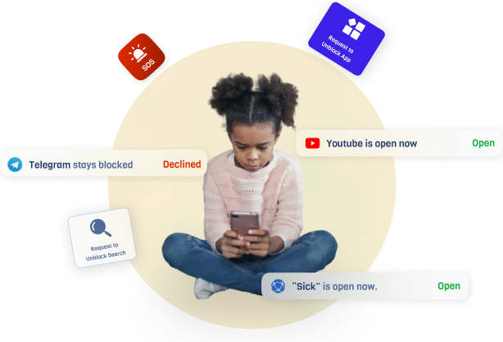
Objectives
The main objective of our project:
Installation control mechanisms.
Privacy-focused OS
Speed improvement
Block Advertisement
Block Data Leak
05-12-2023
05

Slide 7
Background Study
By Researching we found these points to our interest
There is a current Demand for custom ROM on the online market place.^{[2][3]}
People want more Digital privacy.^{[4]}
Parents want more secure ROM for their children.^{[5]}
05-12-2023
06

Slide 8




Existing System
These are most Popular Custom ROM in current market.
LineageOS
Pixel Experience
Paranoid Android
05-12-2023
07

Slide 9
Comparative Analysis
Provided by
Provided by
The device manufacturer
Independent developers
Stock ROM
Performance
Performance
Custom ROM
Less fast and contains bloatware
More faster because of Mods
Control
Control
User has less control
User has less control
05-12-2023
08

Slide 10
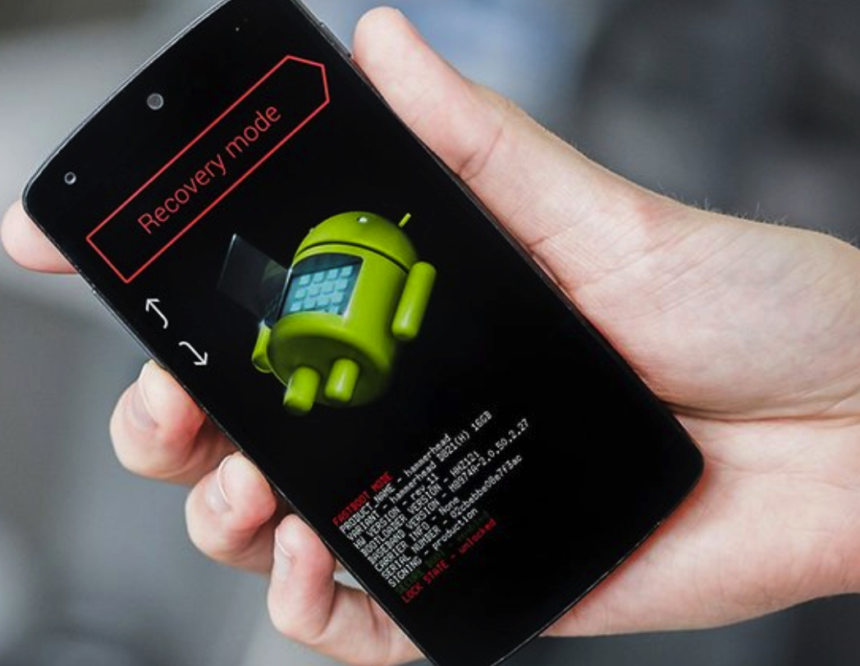
Challenges
The key Challenges behind our project:
Overcoming Bootloader and Security Measures.
Device-specific Drivers and Kernel Issues.
Customization and Feature Integration.
Community and User Expectations.
05-12-2023
09

Slide 11
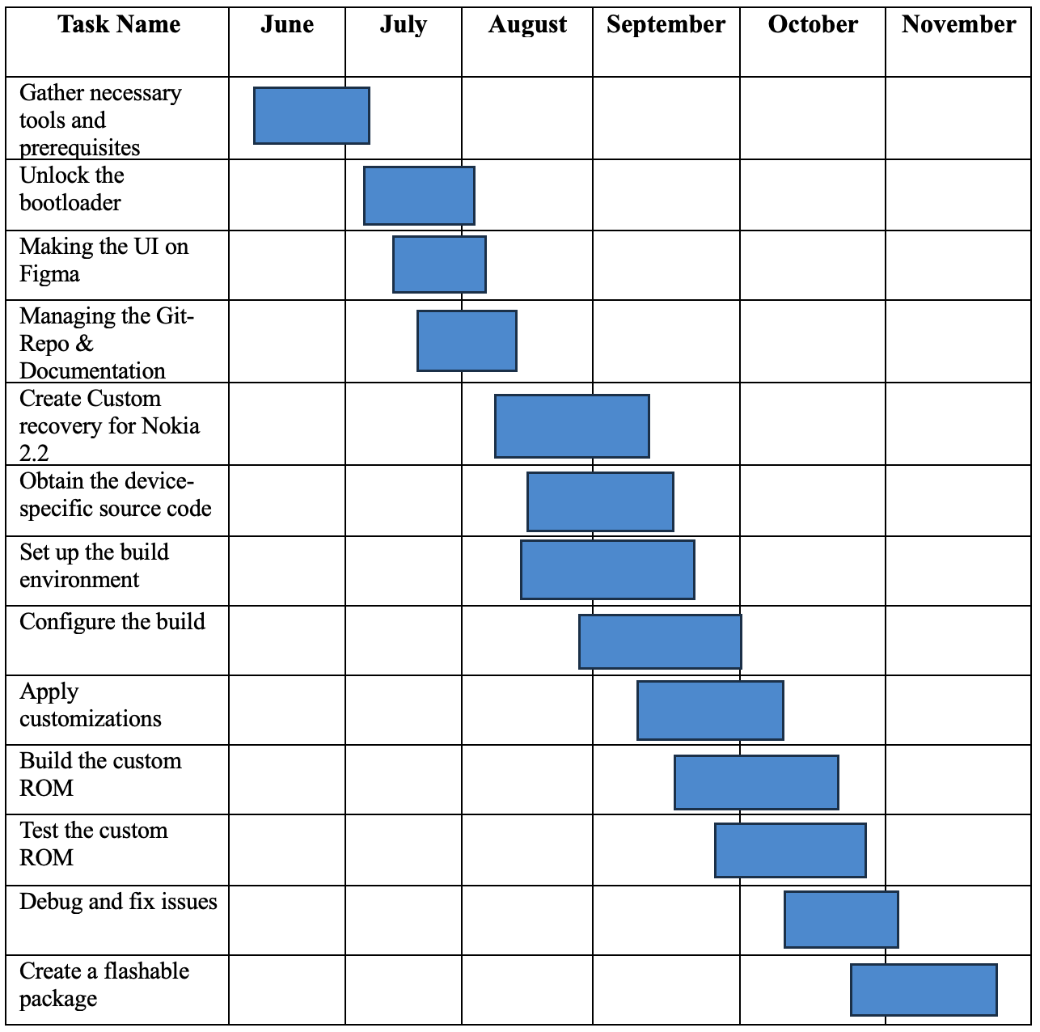
Project planning
05-12-2023
10

Slide 12
Requirement specification
The Requirement for project:
A Computer that supports Windows 10 & Linux
A working android Phone
Good USB cable, Internet and Device Drivers
Stock Rom and Necessary software
05-12-2023
11

Slide 13
Design specification
A design specification (DS) describes how a system meets the requirements outlined in the Functional Requirements. The Basic Design for our project:
Unlock the bootloader
Install custom recovery
Gain root access
Do the necessary modification
05-12-2023
12

Slide 14
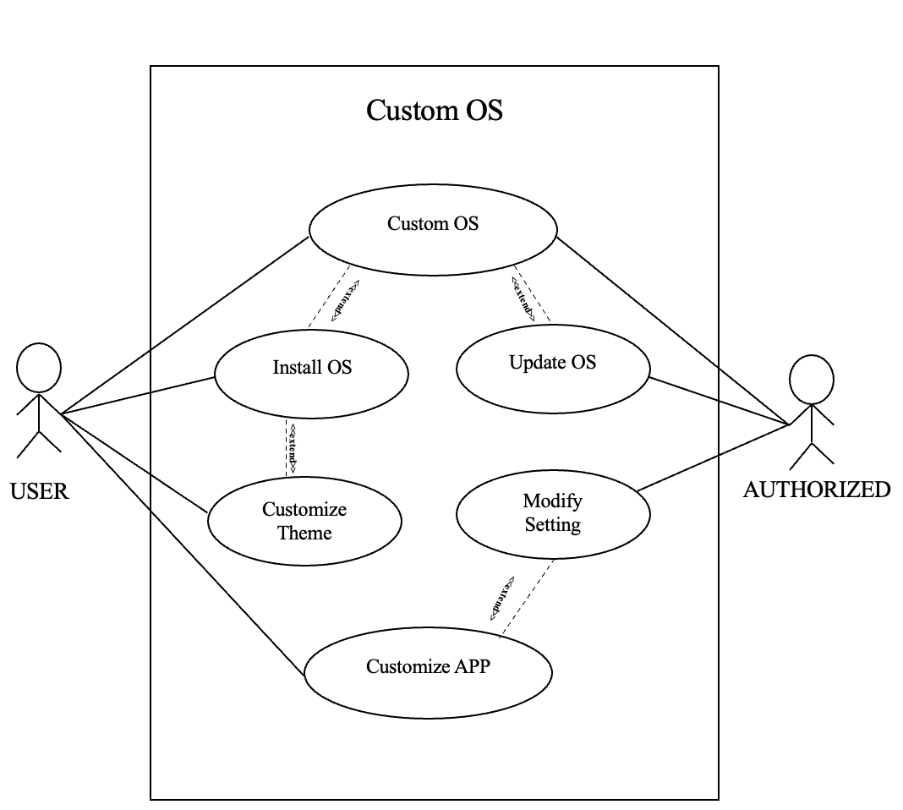
Use Case
Figure-1: Use Case Diagram
05-12-2023
13

Slide 15
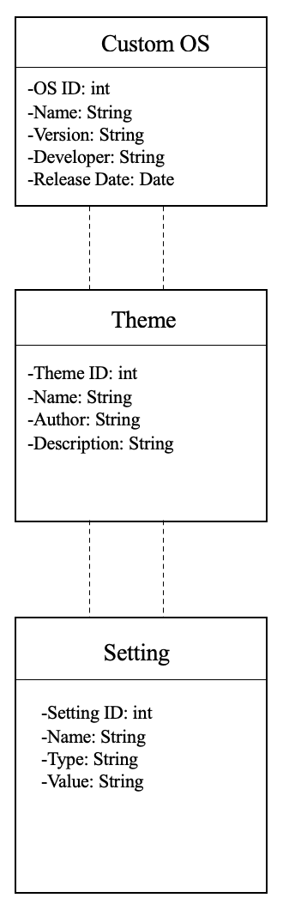
Data Flow
Figure-2: Dataflow Diagram
05-12-2023
14

Slide 16
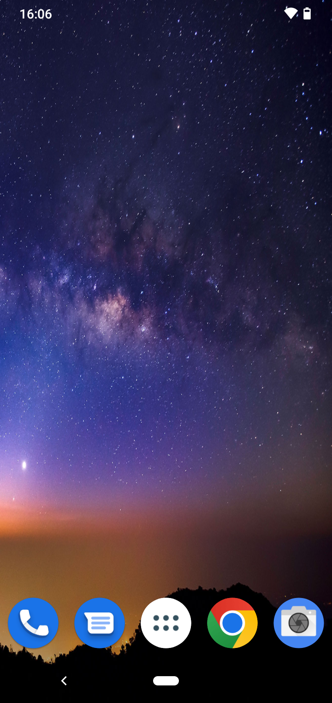
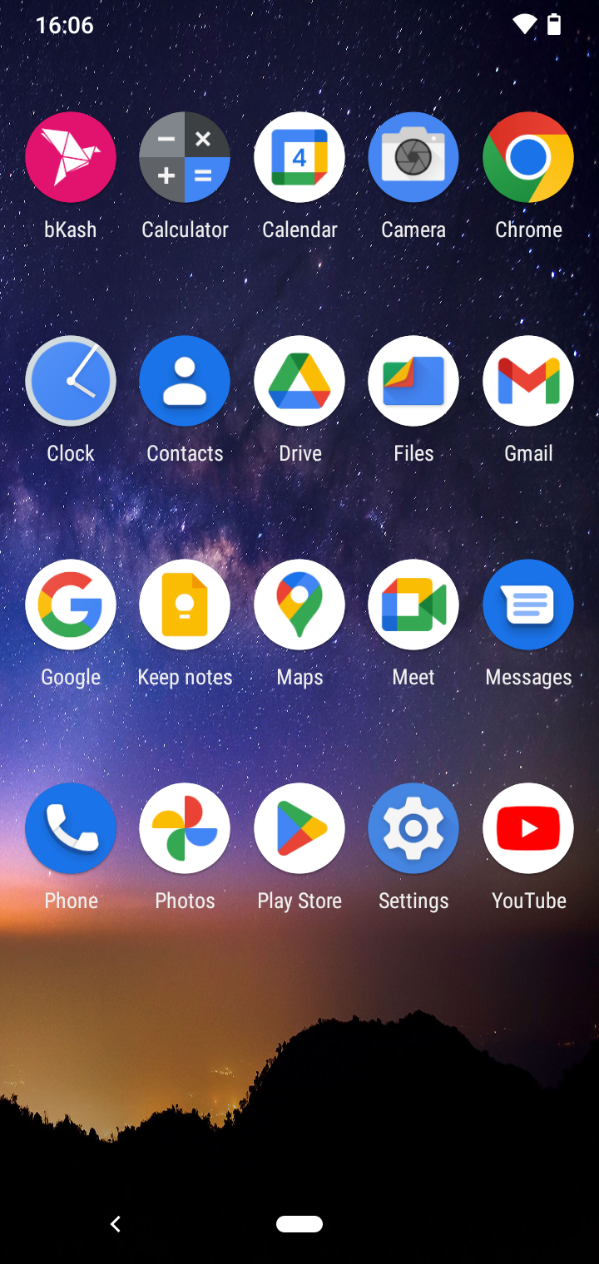
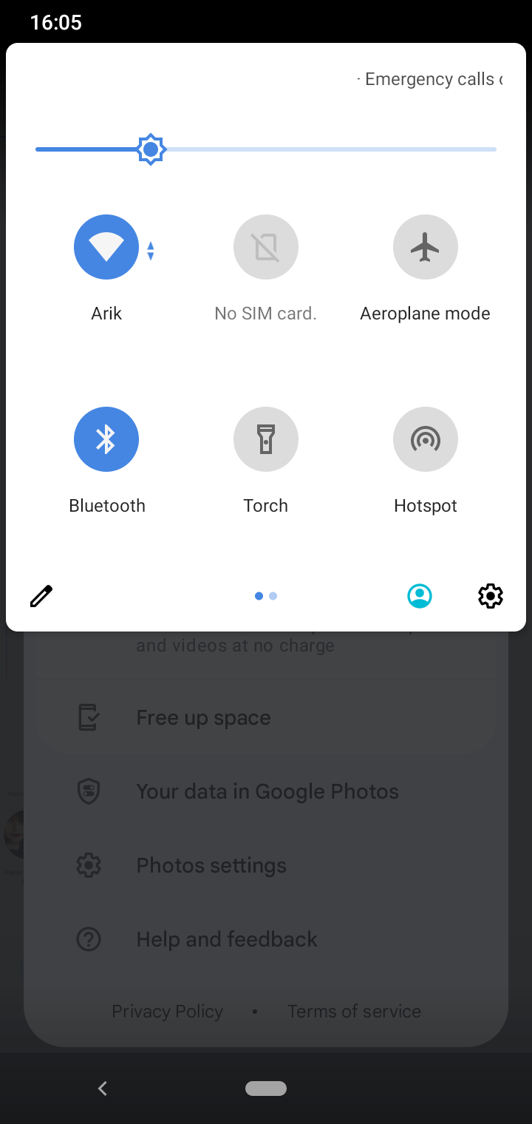
Front End
Fig-01: Modified Home Screen
Fig-02: Modified APP Drawer
Fig-03: Modified Nav Bar 1
05-12-2023
15

Slide 17
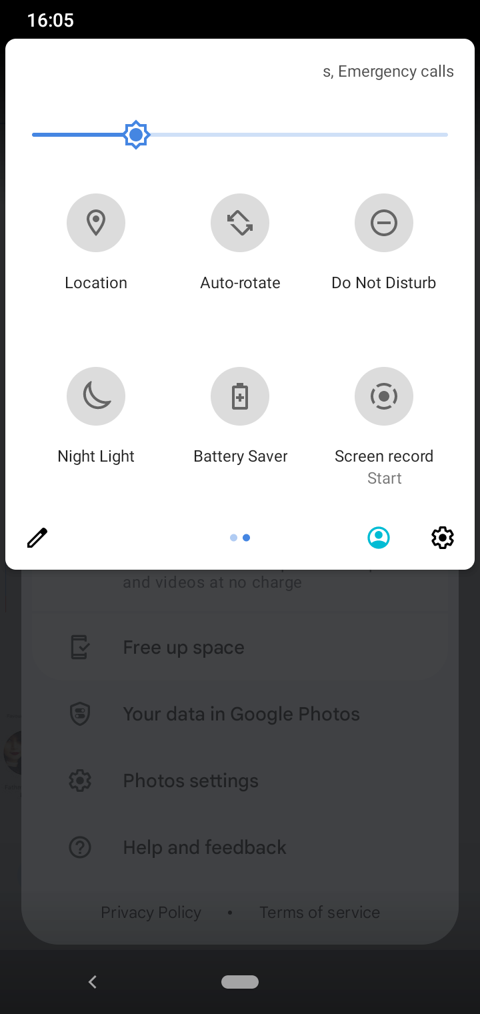
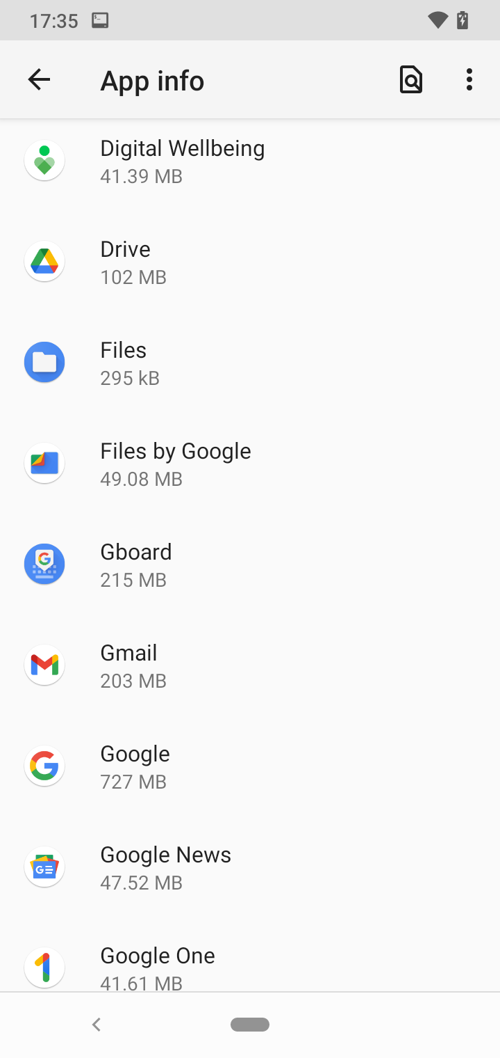
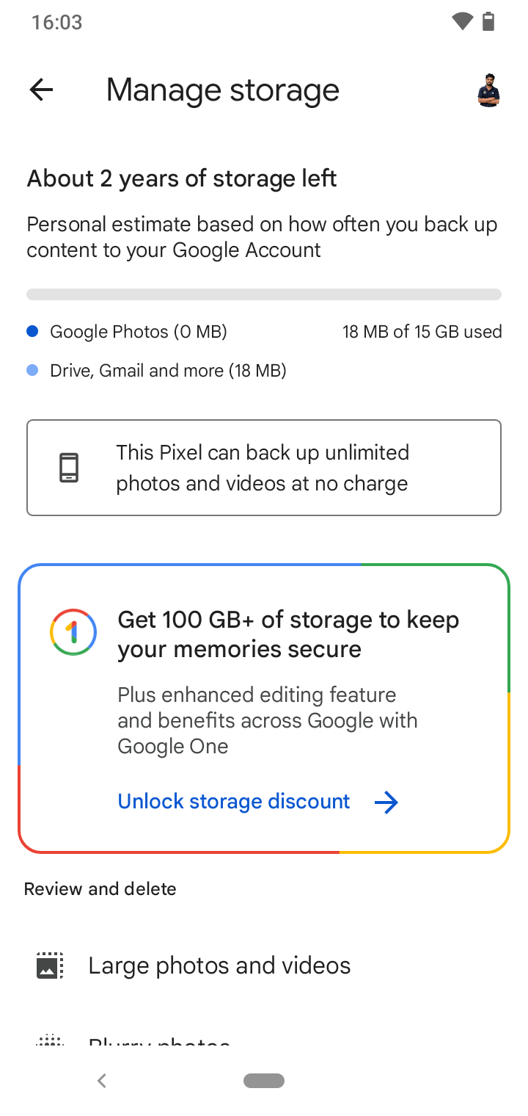
Front End
Fig-04: Modified Nav Bar 2
Fig-05: Uninstall System App
Fig-06: Unlimited google photos
05-12-2023
16

Slide 18
Budget
Hourly Income | Our Project Cost
A average Bangladesh software engineer’s salary per month is 36000 taka. 20 working days and 6 hours of work every day. Hourly Charge 6000/(20*6)=300 taka | (365/7) = 52 working weeks and 12 weeks of vacation. Our lab is 0.75 credits. Total of (0.75*3) = 2.25 hours of is required each week. Total working hours (2.25*40)=90 hours. Cost of three people (300*90*3)=81000 taka.
05-12-2023
17

Slide 19
Cost-Benefit
Total Revenue
40
Break Even Point
TC
VC
COST
20
FC
3
6
SOLD
05-12-2023
18

Slide 20
Impact on Society
Enhanced Device Longevity
Freedom and Customization
Security and Privacy
Community and Collaboration
Learning and Education
05-12-2023
19

Slide 21
Future Work
Security and Privacy Features
Customization and User Experience
Community Engagement and Support
Regular Updates and Feature Innovation
05-12-2023
20

Slide 22
Conclusion
In conclusion, custom ROMs offer users a pathway to personalize and optimize their device experiences beyond manufacturer-provided firmware, fostering a culture of innovation and individualization within the Android ecosystem.
05-12-2023
21

Slide 23
Reference
1 | https://www.linkedin.com/pulse/custom-roms-surya-a/
2 | https://www.fiverr.com/bilaljaved1789/all-android-rom-customization-frimware-customization
3 | https://www.fiverr.com/one_family/advise-how-to-secure-your-custom-android-firmware-or-rom
4 | https://smowl.net/en/blog/digital-privacy/
5 | https://xdaforums.com/t/custom-rom-advice-looking-for-a-kid-friendly-solution.4259189/
6 | They are sorted by theme so you can use them in all kinds of presentations
05-12-2023
22

Slide 24
Thanks!

